Slide 1
RISC-V Vector implementation of autocorrelation on RISC-V vector cores (Arianne/CVA6)
CAMBRIDGE INSTITUTE OF TECHNOLOGY ,KR PURAM BENGALURU
TOPIC: RISC-V Vector implementation of autocorrelation on RISC-V vector cores (Arianne/CVA6)
TEAM MEMBERS:
NAME SEM
1. MANIDEEPA G 6th
2. MOUNA G.S 6th
3. CHANDANA .C 4th
4. GNANESH 4th

Slide 2
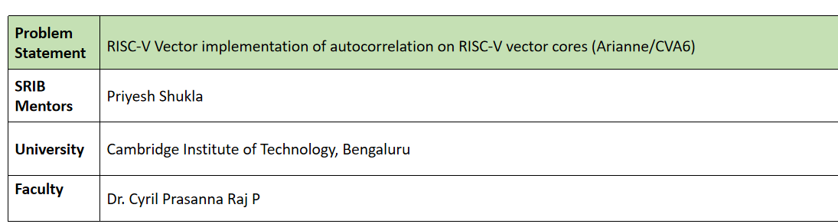

Slide 3
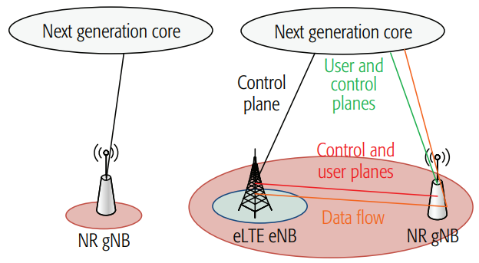


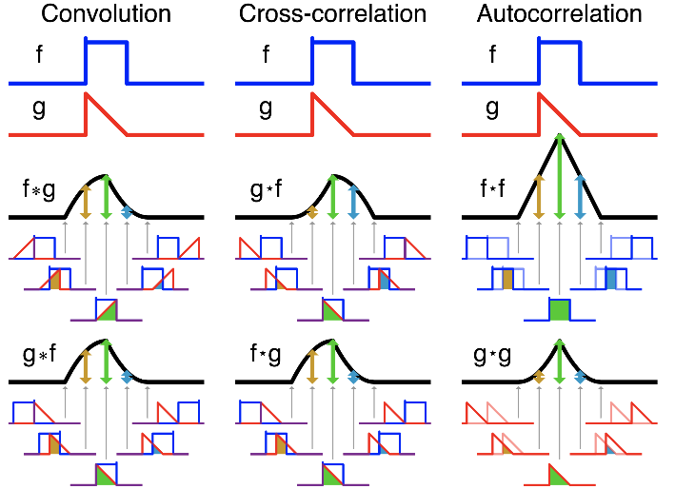
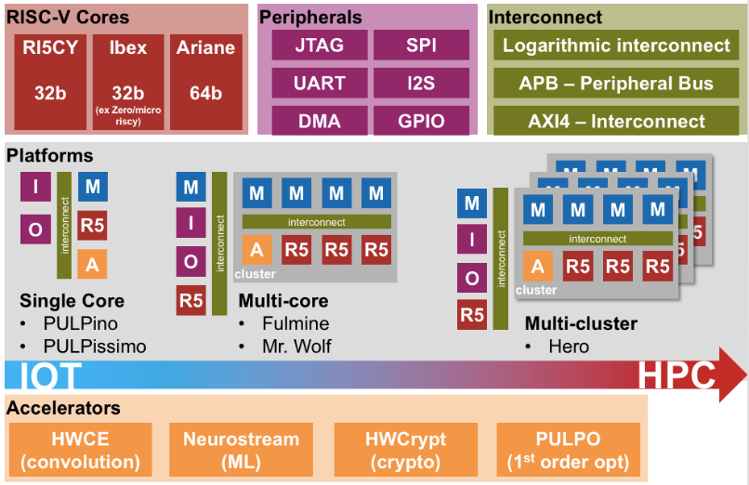
Project summary
Fig. 1. RISC-V instruction set architecture (ISA) based software-hardware ecosystem for communication and multimedia applications for end user.
Goal: Implement & optimize autocorrelation algorithm on PULP RISC-V ISA simulator. Identify and implement hardware intrinsics that significantly accelerate the algorithm on the RISC-V compute platform.
a.
b.
Fig. 2. Algorithm for DSP applications in communication and multimedia. (a) 1D autocorrelation. (b) PULP RISC-V platform.

Slide 4
Proposed approach
Survey and understand RISC-V ISA ecosystem [1][2][3]
Understand the algorithm [4]
Understand PULP, the RISC-V simulation platform, and get hands-on with implementing and profiling simpler functions on PULP DSP and accelerators [5][6][7]
Optimize the algorithm for high performance on RISC-V ISA simulator and analyse profiling statistics (cycle counts of sub-functions and algorithm)
Identify and propose custom extensions or intrinsics for faster implementation of algorithm on the RISC-V platform

Slide 5
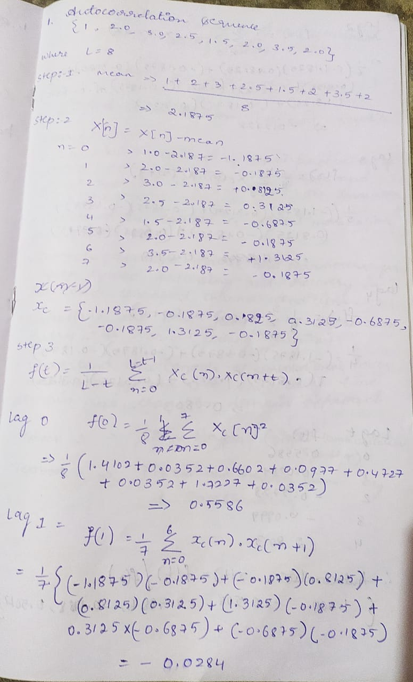
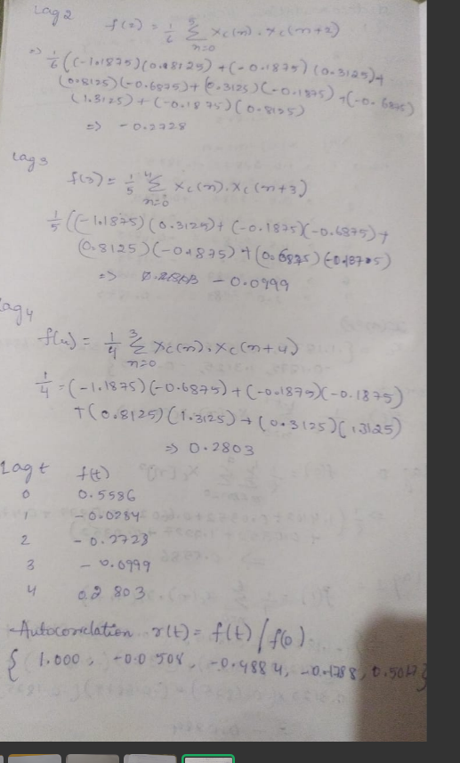
MANUAL CALCULATION

Slide 6
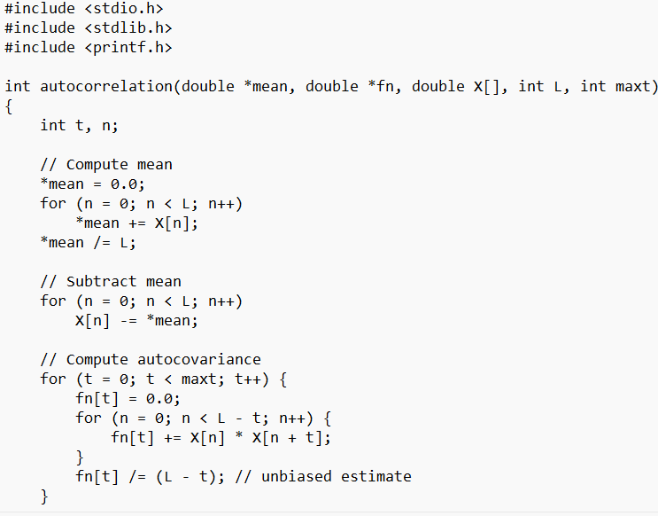
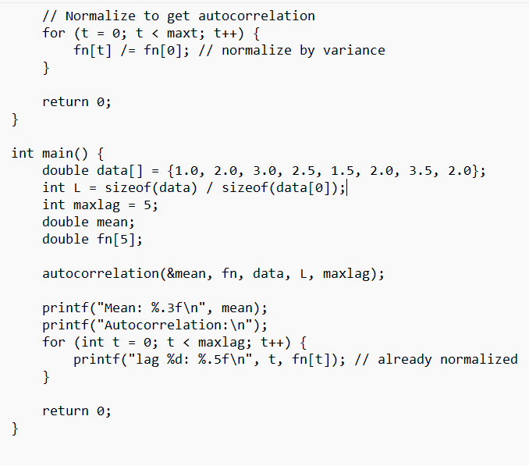
EXAMPLE 1
Program 1:

Slide 7
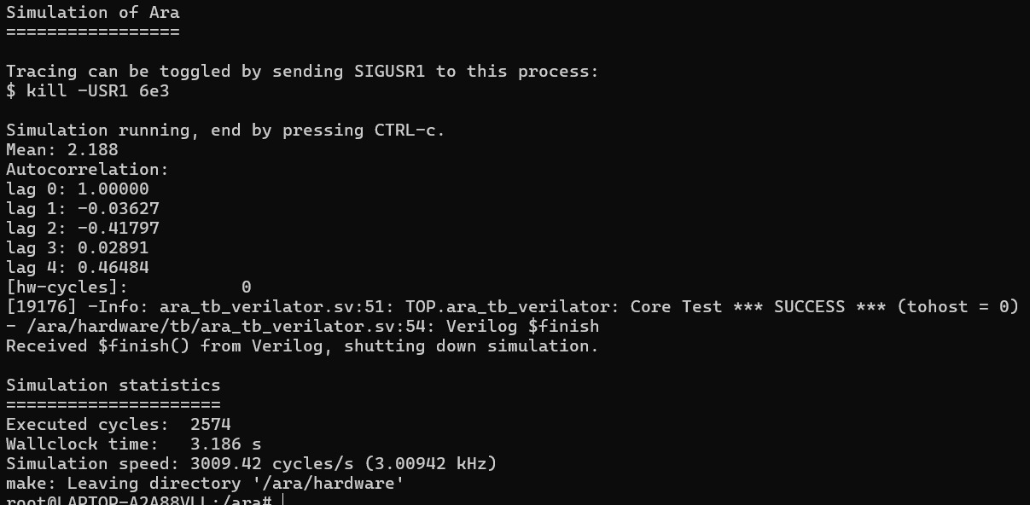
EXAMPLE 1
output :

Slide 8
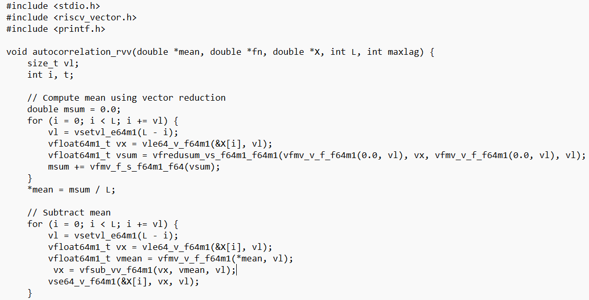
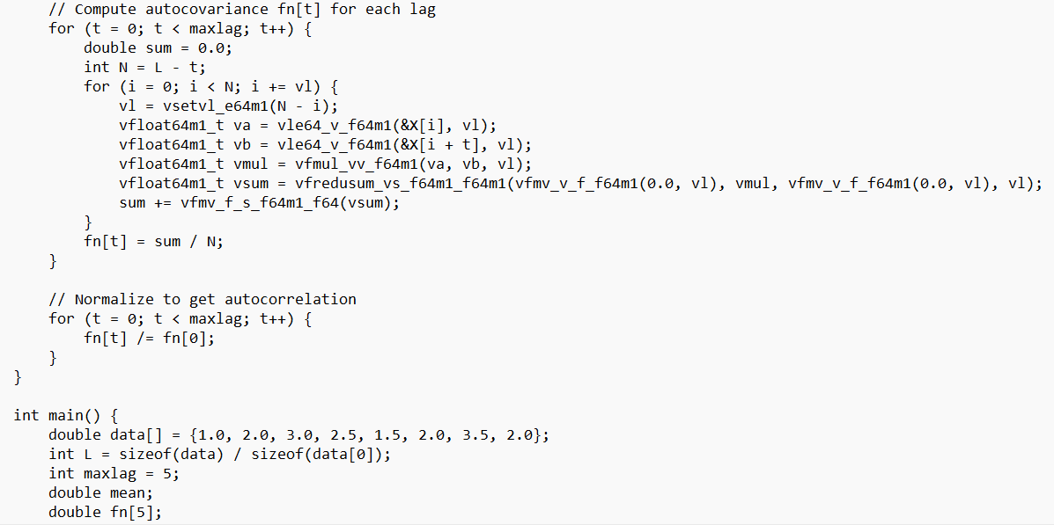
EXAMPLE 2
Program 2:

Slide 9
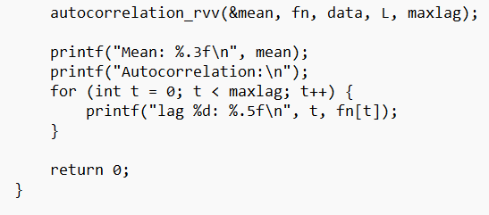
EXAMPLE 2
Program 2

Slide 10
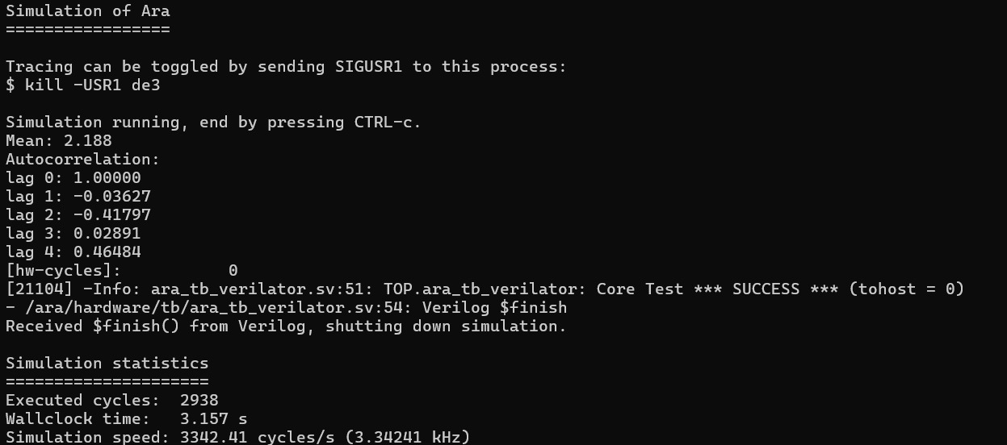
EXAMPLE 2
output

Slide 11
SEQUENCE | EXECUTED CYCLE | WALL CLOCK TIME | SIMULATION
[1.0, 2.0, 3.0, 2.5, 1.5, 2.0, 3.5, 2.0] | (2574)/(0XAOE) | 3.186SEC | 3009.42 CYCLES/SEC
[1.0, 2.0, 3.0, 2.5, 1.5, 2.0, 3.5, 2.0] | (2938)(OXB7A) | 3.157 SEC | 3342.41 CYCLES/SEC

Slide 12
THANK YOU

